Slide 1
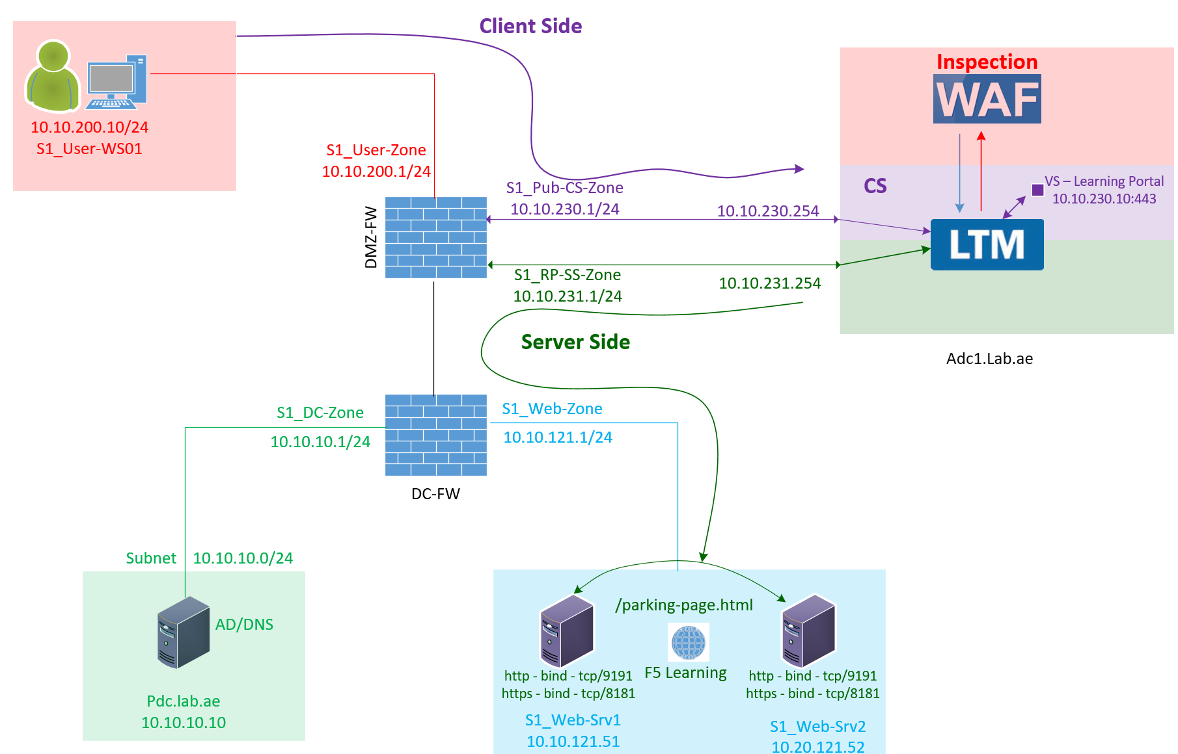

F5 LTM Learning with
Alexander S
Bonus Chapter 04 – Explore and configure the TCP profile in F5 LTM

Slide 2
    TCP Profile in F5 LTM – Client Side & Server Side
Client-side TCP profile
Client ↔ F5
Server-side TCP profile
F5 ↔ Server

Slide 3
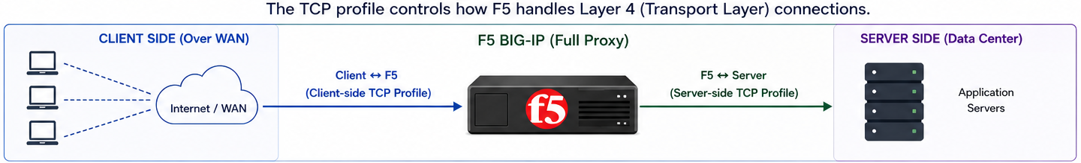
    TCP Profile in F5 LTM
Client-side TCP profile
Client ↔ F5
Server-side TCP profile
F5 ↔ Server
    Why do we need two dedicated profiles?

Slide 4
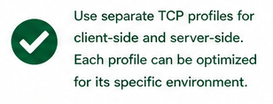
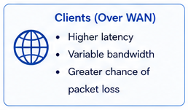
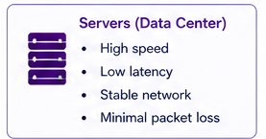
    TCP Profile in F5 LTM – Client Side & Server Side
    Different Network conditions
Client-side TCP profile
Client ↔ F5
Server-side TCP profile
F5 ↔ Server

Slide 5
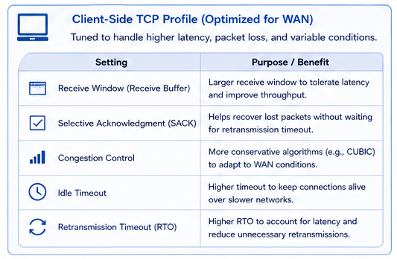
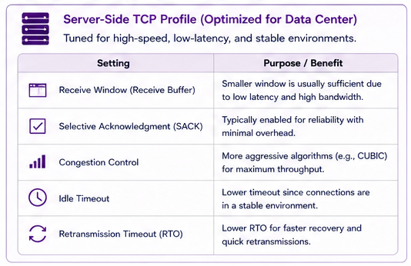
    TCP Profile in F5 LTM – Client Side & Server Side
    Different Network conditions
Client-side TCP profile
Client ↔ F5
Server-side TCP profile
F5 ↔ Server

Slide 6
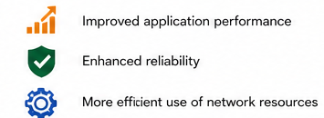
    TCP Profile in F5 LTM
Client-side TCP profile
Client ↔ F5
Server-side TCP profile
F5 ↔ Server

Slide 7
    TCP Profile in F5 LTM
    Some important settings configured in Tcp profiles
Idle Timeout
Tcp Window
Selective Acknowledgement

Slide 8
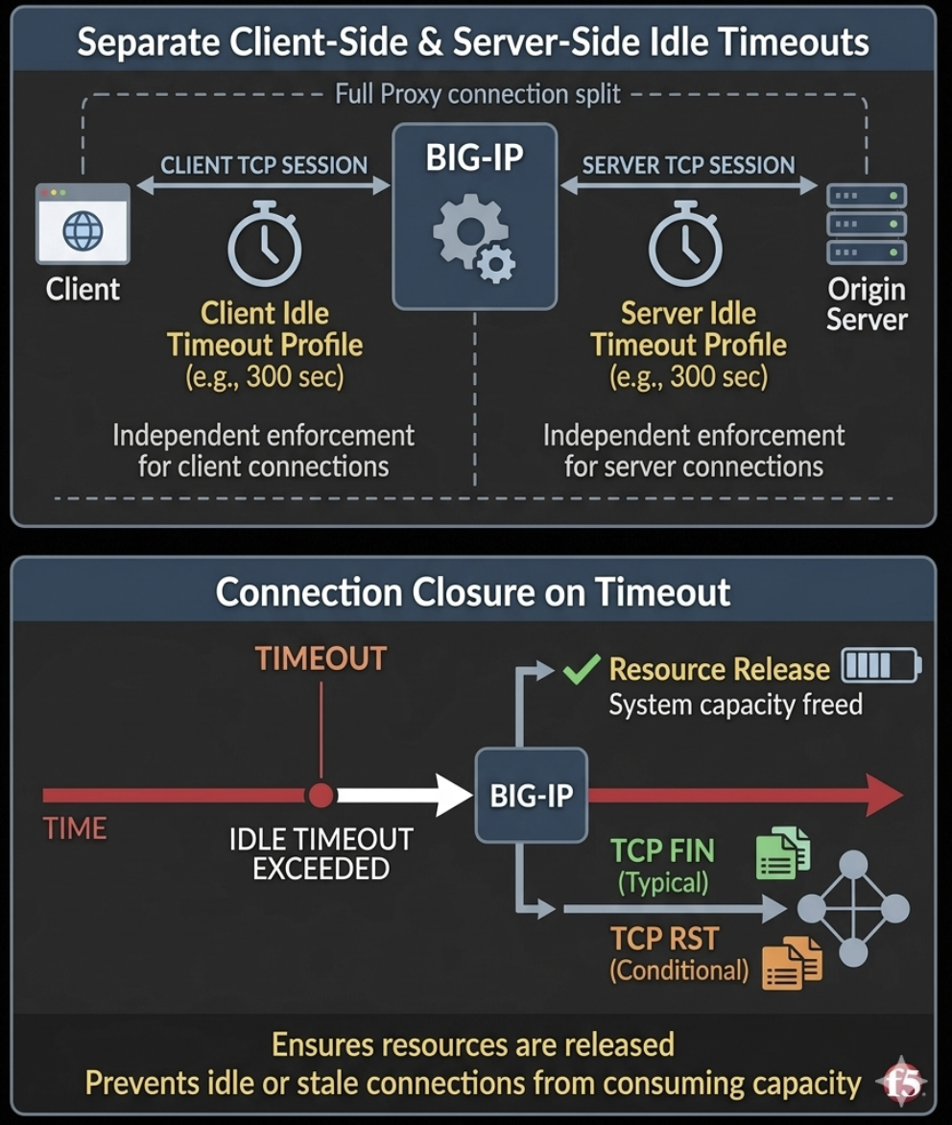
    TCP Profile in F5 LTM
    Some important settings configured in Tcp profiles – Idle Timeout
In BIG-IP full proxy architecture,
Idle timeout is enforced separately on the client-side and server-side TCP connections.
When a connection exceeds the configured idle timeout, BIG-IP typically closes the connection using a TCP FIN, and in some cases a TCP RST, depending on context and configuration.
This ensures resources are released and prevents idle or stale connections from consuming system capacity.
F5 Default Idle timeout is 300 Seconds.

Slide 9
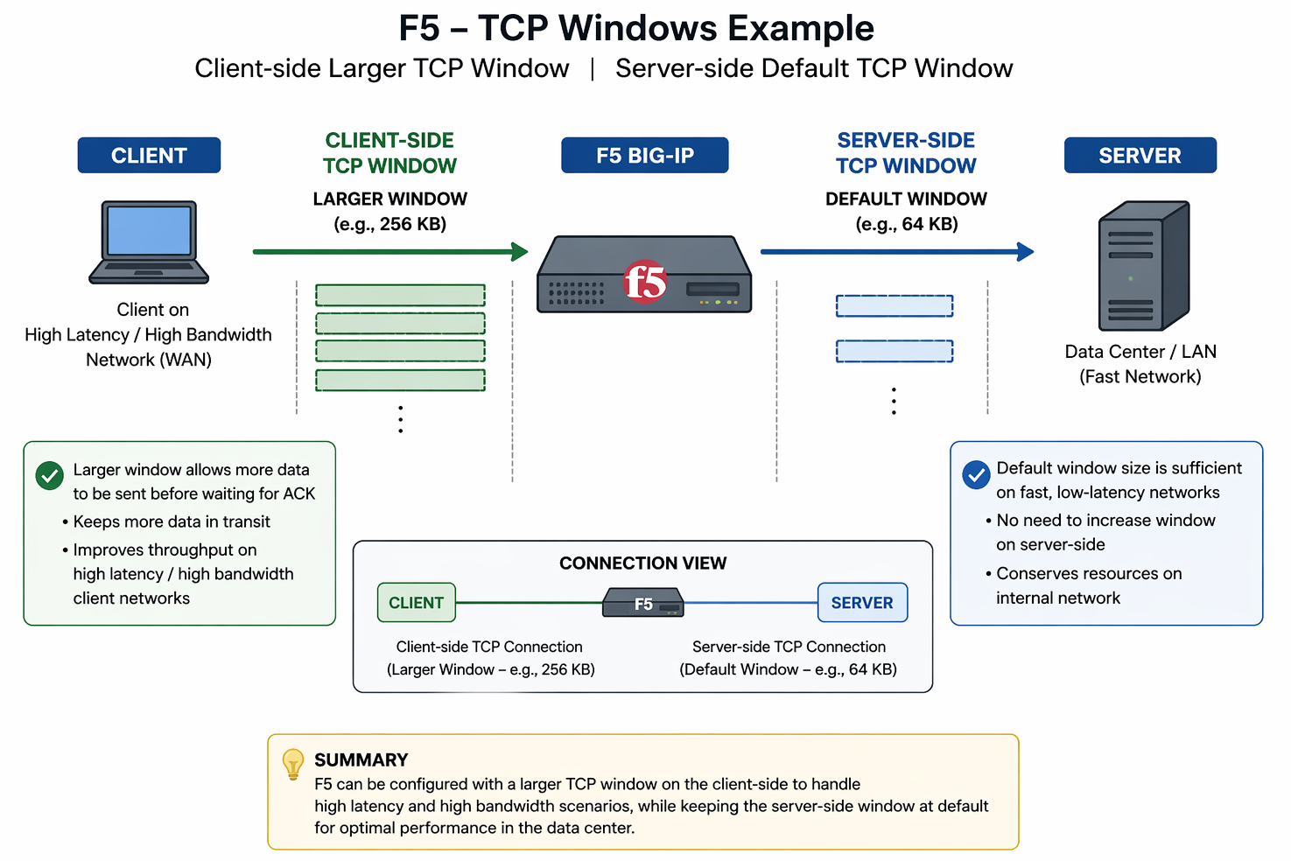
    TCP Profile in F5 LTM
    Some important settings configured in Tcp profiles – Tcp window
Separate TCP profiles on the client-side and server-side.
The client-side TCP window can be increased beyond 64 KB (using window scaling) to improve performance for high-latency networks.
The server-side can remain at the default window size (e.g., 64 KB) for normal LAN conditions.

Slide 10
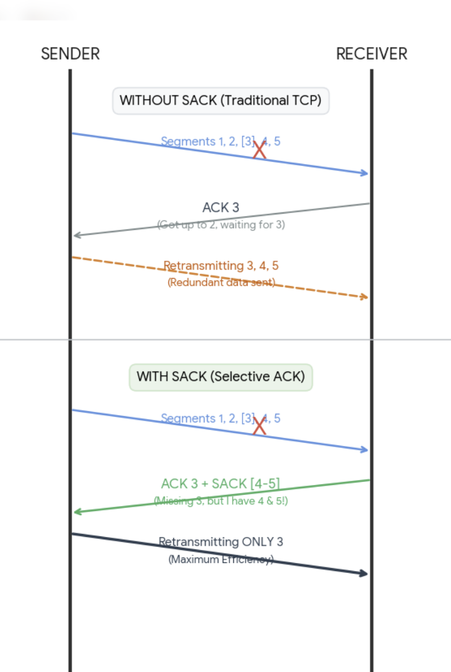
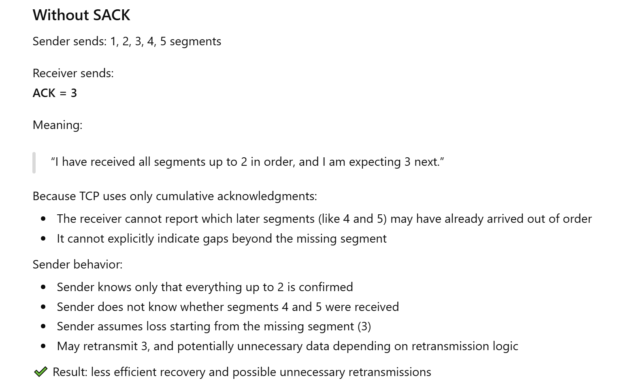
    TCP Profile in F5 LTM
    Some important settings configured in Tcp profiles – Selective ACK

Slide 11
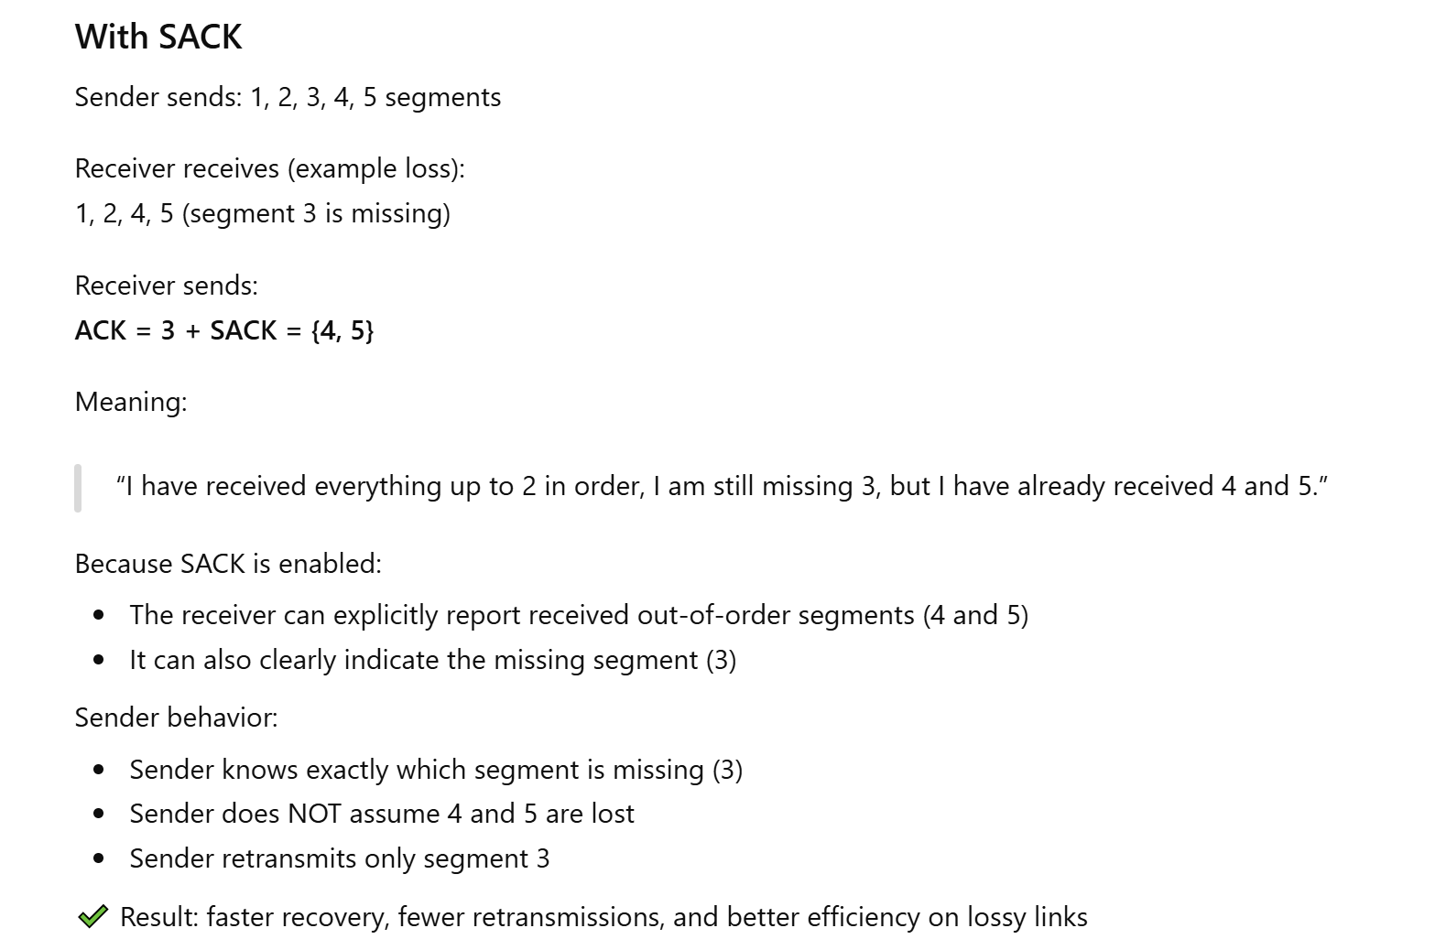
    TCP Profile in F5 LTM
    Some important settings configured in Tcp profiles – Selective ACK
SACK (Selective Acknowledgment) is enabled by default in TCP profiles.

Slide 12
    TCP Profile in F5 LTM
Client-side TCP profile
Client ↔ F5
Server-side TCP profile
F5 ↔ Server

Slide 13
    TCP Profile in F5 LTM
    Custom Tcp Profiles
    Generic_TCP-Client-Side_Profile
      tcp-wan-optimized
        Clients typically connect over WAN networks (higher latency, variable conditions).
        This profile is tuned by F5 for WAN performance ( like setting larger proxy buffers, optimized TCP behavior).
    Generic_TCP-Server-Side_Profile
      tcp-lan-optimized as the parent profile to inherit F5-recommended optimizations for low-latency environments.

Slide 14
    TCP Profile in F5 LTM - Generic_TCP-Client-Side_Profile
    tcp-wan-optimized
    Custom Tcp Profiles
    Generic_TCP-Client-Side_Profile
      tcp-wan-optimized
        Clients typically connect over WAN networks (higher latency, variable conditions).
        This profile is tuned by F5 for WAN performance ( like setting larger proxy buffers, optimized TCP behavior).

Slide 15
    TCP Profile in F5 LTM - Generic_TCP-Server-Side_Profile
    tcp-lan-optimized
    Custom Tcp Profiles
    Generic_TCP-Server-Side_Profile
      tcp-lan-optimized as the parent profile to inherit F5-recommended optimizations for low-latency environments.
Local Area Network

Slide 16
Bonus Chapter 04 – Explore and configure the TCP profile in F5 LTM
This completes the configuration of the TCP Client-Side and TCP Server-Side profiles.
You can now apply these profiles to your Virtual Server to optimize traffic handling between clients and servers.
That brings us to the end of Bonus Chapter 04.
Thank you for watching.

